Slide 1


Slide 2

For students not in my section… I have posted the slides and review material to my website
Head to www.greydongilmore.com
Click on Teaching in the top panel
You will see a list of items under PHYSIOL2130

Slide 3
Midterm #2 Review Sections 09/010
TA: Greydon Gilmore
Physiology 2130
Dec 16th, 2019

Slide 4

Today
Chapter 4: Endocrinology
Chapter 5: Autonomic Nervous System
Chapter 6: Muscle Physiology
Chapter 7: Cardiovascular

Slide 5
Clarifications From Review Session​
On slide #18 it was asked if lipophilic and hydrophobic are the same thing when discussing steroid hormones
Steroid hormones are both lipophilic and hydrophobic​
Lipophilic (fat-loving) gives the steroid hormones the ability to pass through the lipid bilayer to bind intracellular receptors​
Steroid hormones are derived from lipid substances, which means they do not mix with water and are hydrophobic
These terms are not interchangeable as they speak to different attributes of steroid hormones​
On slide #30 it was asked why the post-ganglions in the autonomic NS are unmyelinated
The easiest answer is that some neurons are required to send signals faster than others, the presence of myelin speeds up propagation
The reduction in propagation speed does not affect muscle contraction or gland secretion​

Slide 6
Clarifications From Review Session​
When discussing the cardiac cycle, the events are with respect to the left side of the heart
All valves are closed during the second (Isovolumetric Contraction) and fourth phase (Isovolumetric Relaxation) of the cardiac cycle

Slide 7
Midterm Information
When: December 19th from 9am-10am
What: 35 multiple choice
Endocrinology (Beye) – 4 questions
Autonomic nervous system & Muscle (Stavraky) – 9-11 Questions
Cardiovascular (Stavraky) – 20-22 Questions
Where:
ABBA-GANE: Alumni Hall 15
GHAB-POSA: Alumni Hall 201
PRIM-WOOD: Alumni Hall Stage
WU-ZIA: Somerville House 2316

Slide 8
Study Advice
Get a portable white board
White Board: http://a.co/bNSNYLM
Markers: http://a.co/aJp9YND
Write out flash cards
Study in a group
Make a short PowerPoint presentation and teach your friends/family

Slide 9
Questions from online dropbox/Emails

Slide 10
Can you explain respiratory pump (which area is high pressure, which area is low pressure)
During inhalation you have higher pressure in abdomen and lower in thorax
Blood will move from abdomen to thorax
During exhalation you have higher pressure in thorax and lower in abdomen
Blood will move from thorax to abdomen

Slide 11
Can you explain the process of the baroreceptor reflex (in the perspective of decreased blood pressure/MAP)
Increase in blood pressure (MAP)
Stretches aorta/carotid sinuses
CV center compares signals to set point
Shuts off SNS activates PNS
Decrease CO ( HR and SV causes vasodilation ( TPR))
APs sent to CV center in medulla
Activates baroreceptors
Decreases MAP
In low pressure, baroreceptors reduce their firing
This signals the CV center to shut off PNS and activate SNS

Slide 12
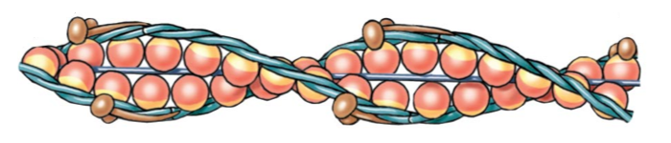
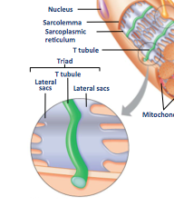
Why does the myosin head attach to the actin and not the myosin binding site? Is calcium released from the SR, or is it stored in the SR and released by the Lateral sac?
G-Actin
The myosin binding site is part of the actin, they are the same structure
Calcium is stored and released by the lateral sacs of the SR
Myosin binding sites

Slide 13
Endocrinology 4 Questions on exam

Slide 14
Which of the following is an incorrect statement concerning the adrenal glands?
an increase in ACTH release will result in increased mineralocorticoid production
the adrenal medulla produces compounds classified as catecholamines
production of cortisol is dependent on cholesterol as a precursor
all the compounds produced by the adrenal cortex will eventually bind intracellular receptors

Slide 15
Which of the following is an incorrect statement concerning the adrenal glands?
an increase in ACTH release will result in increased mineralocorticoid production
the adrenal medulla produces compounds classified as catecholamines
production of cortisol is dependent on cholesterol as a precursor
all the compounds produced by the adrenal cortex will eventually bind intracellular receptors

Slide 16
Which of the following is a correct statement concerning the pancreas?
hyperglycemia causes the release of glucagon, which causes cells to take up glucose
hypoglycemia causes the release of glucagon, which causes cells to release glucose
hypoglycemia causes the release of insulin, which causes cells to take up glucose
hyperglycemia causes the release of insulin, which causes cells to release glucose

Slide 17
Which of the following is a correct statement concerning the pancreas?
hyperglycemia causes the release of glucagon, which causes cells to take up glucose
hypoglycemia causes the release of glucagon, which causes cells to release glucose
hypoglycemia causes the release of insulin, which causes cells to take up glucose
hyperglycemia causes the release of insulin, which causes cells to release glucose

Slide 18
Types of Hormones
Hormone: A chemical signal secreted into the bloodstream to act on a distant tissue
The target cells of the hormone need the receptor
Parameter | Peptide/Protein | Steroid | Amine
 |  |  | Hydrophilic | Hydrophobic
Examples | Hormones that end in “-in” | Hormones that end in “-ol” or “-one” | Epinephrine | Thyroid Hormones
Precursor | Amino acids | Cholesterol | Tyrosine | Tyrosine
Solubility | Hydrophilic | Lipophilic | Hydrophilic | Hydrophobic
Blood transport | Dissolves | Bound to protein | Dissolves | Carrier protein
Receptor location | Cell surface | Intracellular | Extracellular | Intracellular
Speed of action | Fast | Slow | Fast | Slow
Goal | Alter existing proteins | Produce new proteins | Alter proteins | Produce new proteins

Slide 19
Adrenal Gland: Layers
 | Layers | Categories of Hormones | Example | Stimulus | Effect
Cortex | Zona glomerulosa | Mineralocorticoids | Aldosterone | RAAS pathway (@ low BP) | Increase Na⁺ reabsoprtion
Cortex | Zona fasciculata | Glucocorticoids | Cortisol | ACTH | -
Cortex | Zona reticularis | Androgens | DHEA | - | -
Medulla | Medulla | Catecholamines | Epinephrine | Sympathetic Nervous System | SNS response
Three classes of steroids: Mineralocorticoids, Glucocorticoids and Androgens

Slide 20
Cortisol
Cortisol
Muscle
Liver
Adipose
Protein catabolism
Gluconeogenesis
Lipolysis
Immune system
Immune suppression
Proteins into amino acids
Form new glucose from amino acids, glycerol and other substrates
Triglycerides into glycerol and fatty acids
Decrease inflammatory mediators
Cortisol is catabolic: Break down larger molecules
Cortisol levels peak early morning and decline throughout the day
Cushing’s disease (hypercortisolism): thinning skin, muscle wasting and weakness, stunted growth, increased infections, redistribution of fat tissue

Slide 21
Pancreas
 | Glucagon | Insulin
Tissue | Islet of Langerhans | Islet of Langerhans
Made by | α- cells | β- cells
Stimulus | Blood glucose Hypoglycemia | Blood glucose Hyperglycemia
Effect | Blood glucose (cells release glucose) | Blood glucose (cells take up glucose)
Class | Peptide | Peptide
Antagonistic Effect

Slide 22
Autonomic Nervous System & Muscle 9-11 Questions on exam

Slide 23
Which of the following physiological responses results from sympathetic action?
increase in heart rate
constriction of blood vessels
stimulation of gluconeogenesis/glycogenolysis
all the above

Slide 24
Which of the following physiological responses results from sympathetic action?
increase in heart rate
constriction of blood vessels
stimulation of gluconeogenesis/glycogenolysis
all the above

Slide 25
The two branches of the autonomic nervous system display which of the following properties?
up-down regulation by tonic control
antagonistic control
preservation of homeostasis
all of the above

Slide 26
The two branches of the autonomic nervous system display which of the following properties?
up-down regulation by tonic control
antagonistic control
preservation of homeostasis
all of the above

Slide 27
Nervous System Divisions

Slide 28
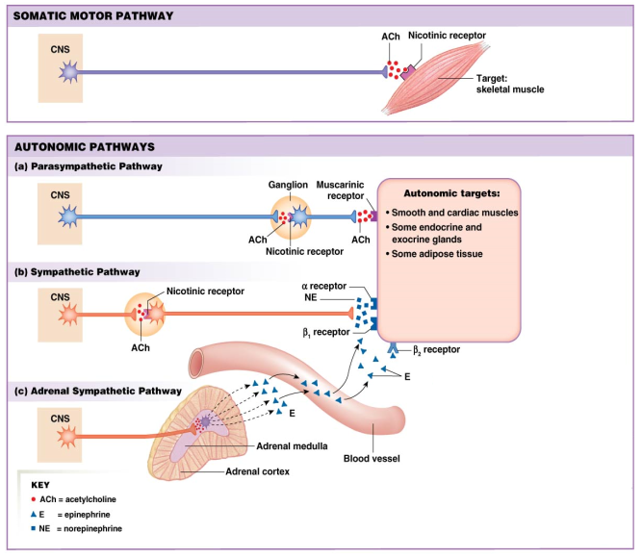
Comparison of Autonomic and Somatic Motor Systems
Somatic
Motor neuron releases Ach directly onto muscle cells/fibers → contraction
Parasympathetic
Preganglionic long, postganglionic short
Preganglionic release Ach
Postganglionic release Ach
Sympathetic
Preganglionic short, postganglionic long
Preganglionic release Ach
Postganglionic release NE
Adrenal gland only has preganglionic, which releases Ach → epinephrine

Slide 29
Sympathetic vs. Parasympathetic
Responses are usually antagonistic
But there are exceptions:
Complimentary effect: saliva production
PNS → stimulate water and enzymes
SNS → stimulate thick mucous
Cooperative effect: sexual function
PNS → induces erection, engorgement and secretions
SNS → Induces ejaculation, stimulates contraction

Slide 30
Autonomic vs. Somatic Motor Systems
 | Autonomic | Somatic
Voluntary? | No | Yes
Myelination | Preganglionic – Myelinated Postganglionic – Non-myelinated | Myelinated
Number of neurons in path | Two | One
Efferent Transmitter | Acetylcholine and Noradrenaline | Acetylcholine
Target tissue | Smooth and cardiac muscle Adipose tissue, endocrine/exocrine glands | Skeletal muscle
Effect on target | Excitatory or inhibitory | Excitatory (Muscle contracts)

Slide 31
Parasympathetic vs. Sympathetic
 | Parasympathetic (PSNS) | Sympathetic (SNS)
Preganglionic Neurotransmitter | Acetylcholine | Acetylcholine
Postganglionic Neurotransmitter | Acetylcholine | Norepinephrine
Location of autonomic ganglion? | Close to organ | Close to spinal cord
Innervates adrenal medulla? | No | Yes
When would you observe more activation? | Rest & Digest | Fight & Flight
If activated, what is the effect on heart rate? | Slows heart rate | Increases heart rate
If activated, what is the effect on breathing? | Constricts airways | Relaxes airways
Give an example of an organ/function with antagonistic effect. | Constricts pupils Increases digestion (ie. increases bile secretion, stomach motility increased Increases secretions from pancreas | Dilates pupils Decreases digestion (reduces bile secretions, decreases stomach motility) Decreases secretions from pancreas
Give an example of a cooperative effect. | Genitalia M/induces erection F/engorgement and secretions | Genitalia M/induces ejaculation F/stimulates contractions

Slide 32
Which is the correct structural organization of skeletal muscle?
whole muscle, muscle fiber, fascicle, myofibril, myofilaments
whole muscle, muscle fiber, myofibril, Fascicle, myofilaments
whole muscle, fascicle, muscle fiber, myofibril, myofilaments
whole muscle, fascicle, myofibril, muscle fiber, myofilaments

Slide 33
Which is the correct structural organization of skeletal muscle?
whole muscle, muscle fiber, fascicle, myofibril, myofilaments
whole muscle, muscle fiber, myofibril, Fascicle, myofilaments
whole muscle, fascicle, muscle fiber, myofibril, myofilaments
whole muscle, fascicle, myofibril, muscle fiber, myofilaments

Slide 34
In the cross-bridge formation cycle between actin and myosin, what is the result of ATP hydrolysis?
power stroke
increase myosin head affinity for actin
cross bridge release (muscle relaxation)
cross bridge formation

Slide 35
In the cross-bridge formation cycle between actin and myosin, what is the result of ATP hydrolysis?
power stroke
increase myosin head affinity for actin
cross bridge release (muscle relaxation)
cross bridge formation

Slide 36
What is the difference between unfused and complete tetanus?
recruitment of more motor units
greater Ca²⁺ release from the SR
increased motor neuron stimulation
greater SNS stimulation

Slide 37
What is the difference between unfused and complete tetanus?
recruitment of more motor units
greater Ca²⁺ release from the SR
increased motor neuron stimulation
greater SNS stimulation

Slide 38
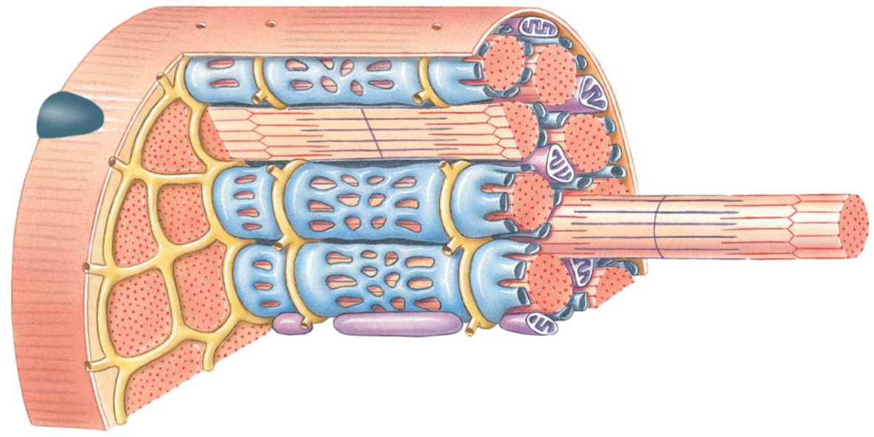
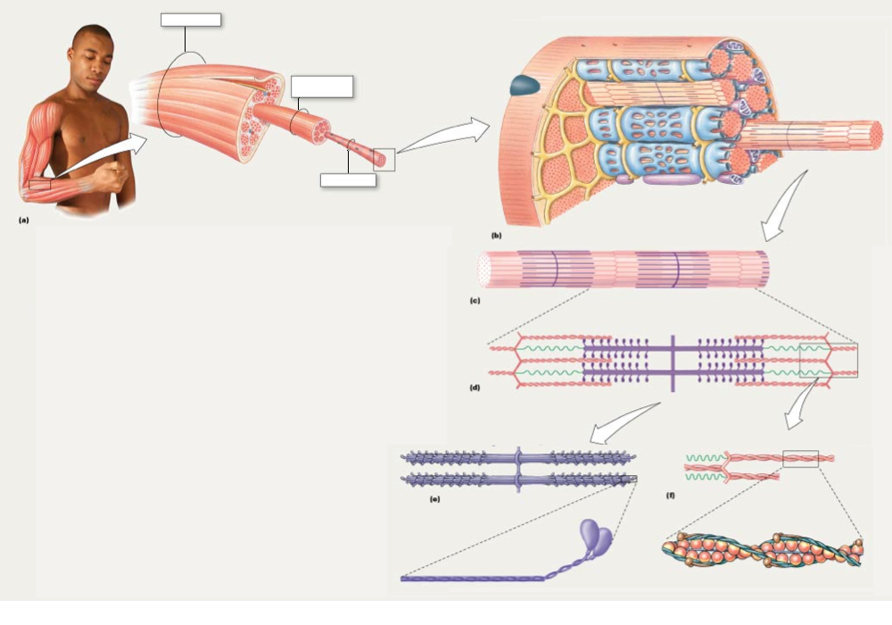
Muscle Structure
Sarcolemma
Whole Muscle
Sarcoplasmic Reticulum
(SR)
Fascicle
Transverse (T) tubules
Lateral Sac
(Terminal Cisternae)
of SR
Muscle Cell/Fiber
Myofibril

Slide 39
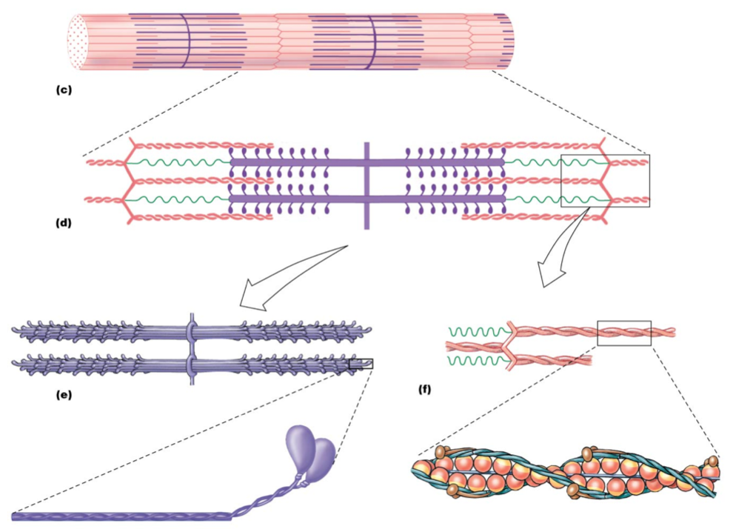
Muscle Structure
Myofibril
Sarcomere
Myofilaments
Thick Myofilament
Thin Myofilament

Slide 40
Thin Myofilament
Myosin binding sites
G-Actin
Troponin
Tropomyosin
G-actin: forms alpha-helical chain with other G-actins and contains a myosin binding site
Tropomyosin: in relaxed state, tropomyosin works to cover the myosin binding sites on g-actin
Troponin: attached to tropomyosin and actin to hold tropomyosin over the myosin binding sites in relaxed state

Slide 41
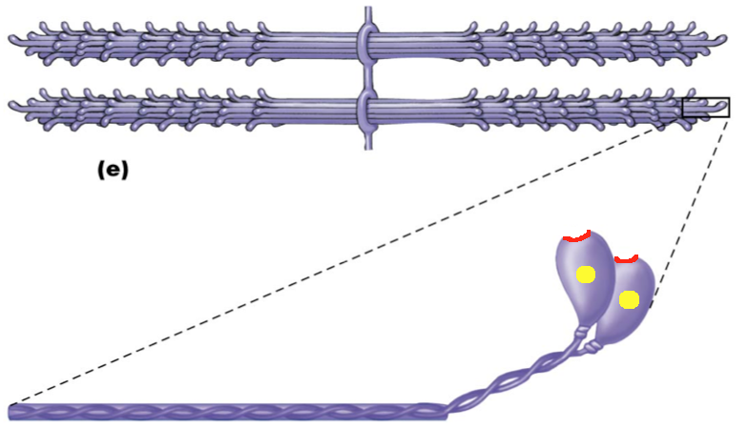
Thick Myofilament
Actin binding sites
Myosin Head
Myosin Tail
ATP binding sites
(ATPase)
Thick filament contains many myosin molecules
Each head has a binding site for Actin and an ATPase
Breaks down ATP into ADP + P_{i} and releases energy for contraction

Slide 42
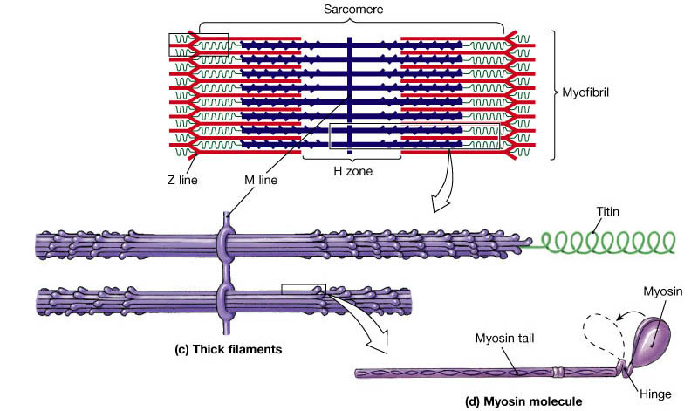
The Sarcomere
Thin Filaments
Thick Filaments
Z-line: where thin myofilaments are joined together
Sarcomere: area between the z-lines, which is smallest functional unit of muscle
Myosin head binds to G-actin on thin filament forming a cross-bridge. A Power Stroke is initiated an a muscle contraction will occur

Slide 43
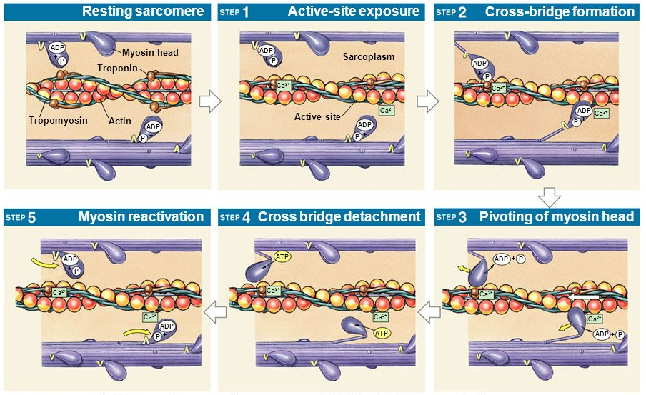
The Sliding-Filament Theory
Ca²⁺ binds troponin, causes tropomyosin to roll off and expose myosin binding site
Myosin head binds actin binding site, cross-bridge formation
P_{i} released from myosin head causing power stroke (muscle contraction)
ADP released, myosin still bound to actin until new ATP attached, myosin head detaches (cross-bridge broken)
ATP hydrolyzed to ADP + P_{i}
Cross-bridge is the connection of myosin head to actin (once binding site is clear). Cross-bridge will allow power stroke to occur (muscle contraction)

Slide 44
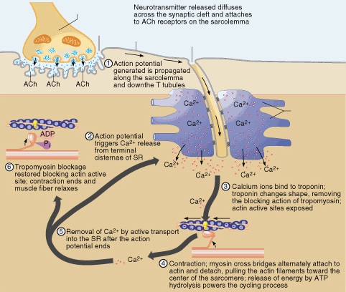
The Neuromuscular Junction and Sarcomere

Slide 45
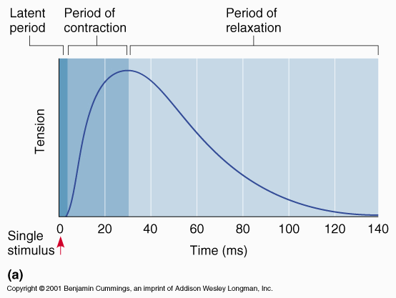
Muscle twitch
Result of one AP from the motor neuron
Difference in AP duration vs. twitch duration = allows summation

Slide 46
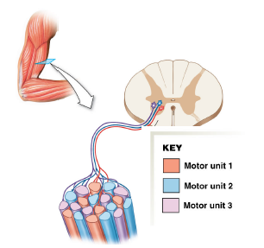
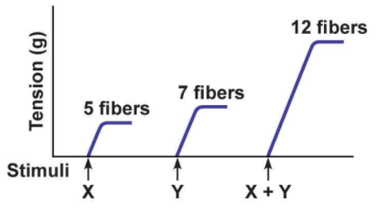
Grading of muscle contraction
Recruitment
Recruiting additional motor units
e.g. motor unit 1 innervates 6 fibers
Summation
Increase the twitch frequency in the same motor unit (summation)

Slide 47
Tetanus
Unfused tetanic contraction (or unfused tetanus)
Medium to high frequency APs will cause twitches to summate
Still has time to relax before next twitch
Complete tetanus
At very high frequencies there is no relaxation between twitches
Twitches will summate to form smooth, sustained contraction

Slide 48
Cardiovascular 20-22 Questions on exam

Slide 49
Which of the following pairings is NOT correct?
primary artery of the systemic circulation → aorta
narrow end of the heart that points downward → base
valve between ventricle and a main artery → semilunar
tough membranous sac that encases the heart → pericardium
all of the above are true.

Slide 50
Which of the following pairings is NOT correct?
primary artery of the systemic circulation → aorta
narrow end of the heart that points downward → base
valve between ventricle and a main artery → semilunar
tough membranous sac that encases the heart → pericardium
all of the above are true.

Slide 51
The _______ supply blood to the heart muscle itself.
coronary arteries
coronary veins
pulmonary arteries
pulmonary veins

Slide 52
The _______ supply blood to the heart muscle itself.
coronary arteries
coronary veins
pulmonary arteries
pulmonary veins

Slide 53
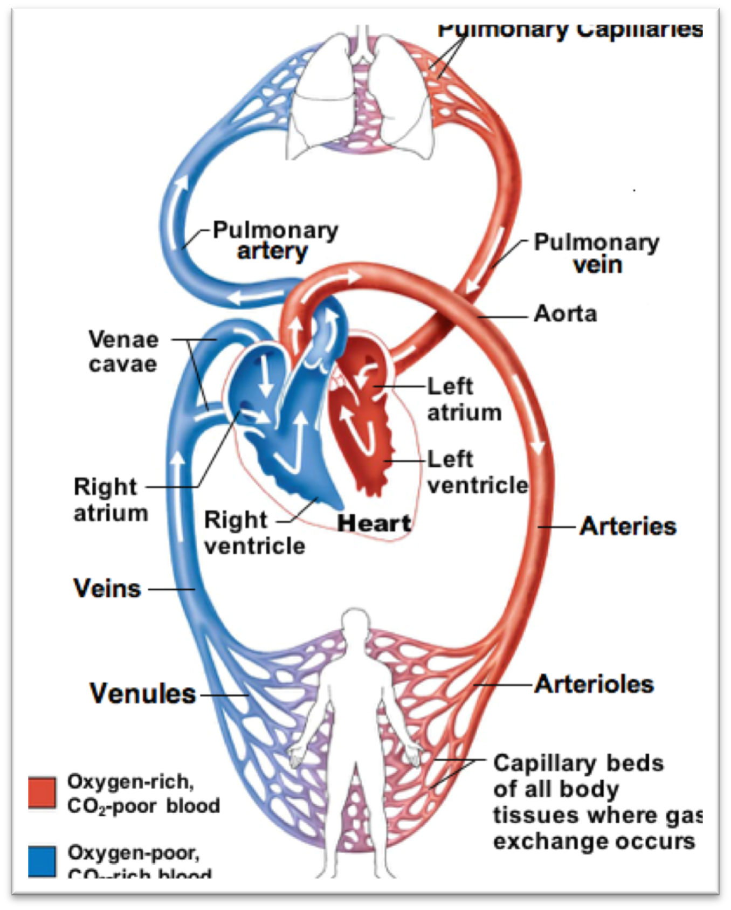
Blood volume distribution
Total Blood Volume (TBV) = 5 liters
Heart and Pulmonary circ. = 15%
Systemic arteries/arterioles = 10%
distribution vessels
Systemic capillaries = 5%
exchange vessels
Systemic veins/venules= 70%
capacitance vessels
low pressure, require valves to stop backflow

Slide 54
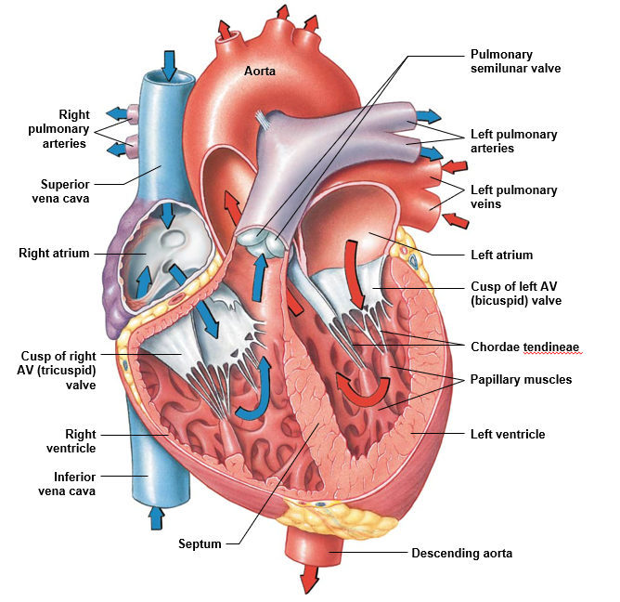
Heart Flow

Slide 55
Which of the following is the correct sequence for the spread of cardiac action potentials?
SA node → internodal pathways → AV node → AV bundle → bundle branches → Purkinje fibers
SA node → AV node → internodal pathways → AV bundle → bundle branches → Purkinje fibers
SA node → internodal pathways → AV node → bundle branches → AV bundle → Purkinje fibers
SA node → internodal pathways → AV node → AV bundle → Purkinje fibers → bundle branches

Slide 56
Which of the following is the correct sequence for the spread of cardiac action potentials?
SA node → internodal pathways → AV node → AV bundle → bundle branches → Purkinje fibers
SA node → AV node → internodal pathways → AV bundle → bundle branches → Purkinje fibers
SA node → internodal pathways → AV node → bundle branches → AV bundle → Purkinje fibers
SA node → internodal pathways → AV node → AV bundle → Purkinje fibers → bundle branches

Slide 57
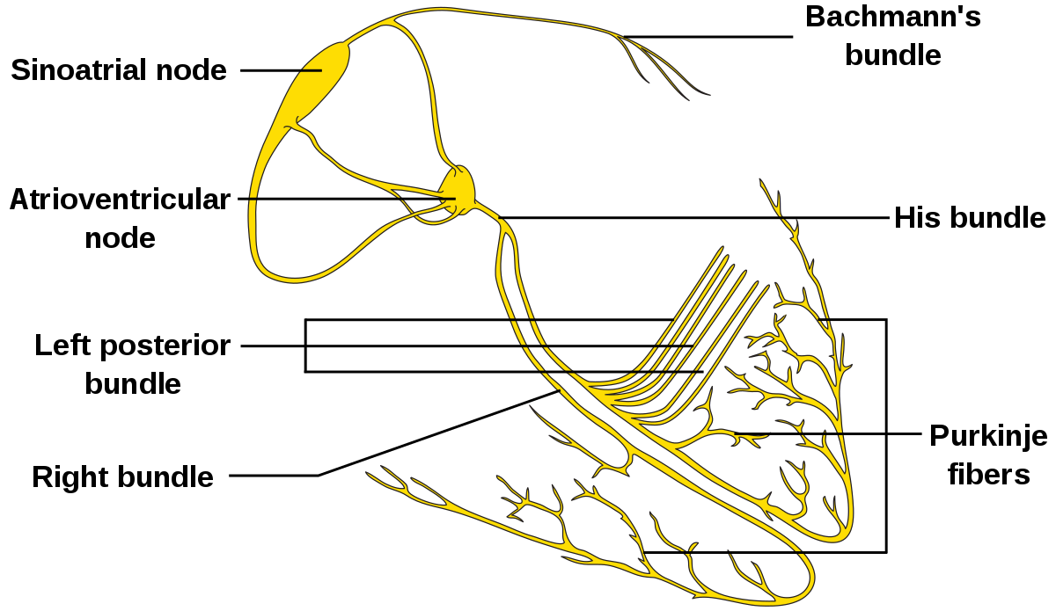
Signal Flow
SA Node: Pacemaker of the heart
How does it generate fast spontaneous APs?
greater permeability to Na⁺ and Ca²⁺
decreased permeability to K⁺
These properties naturally bring the cell to threshold

Slide 58
SA Node Action potential

Slide 59
Compare/Contrast – Action Potentials
 | Action Potential | Cardiac AP
RMP | RMP = -70 mV | RMP = ~-60 mV
Threshold | Threshold = -55 mV | Threshold = -40 mV
Stimulus | Graded Potential | Slow Leak (Na⁺/Ca²⁺)
Depol. Channels | Depolarization = VG Na⁺ | Depolarization = VG Ca²⁺
Repol. Channels | Repolarization = VG K⁺ | Repolarization = VG K⁺
Hyperpol. | Hyperpolarization = Leak channels | N/A

Slide 60
Which of the following is INCORRECT regarding diastole (filling of the heart)?
atrioventricular valves are open
semilunar valves are closed
blood is flowing from the atria into the ventricles
pressure in the ventricles is greater than in the atria

Slide 61
Which of the following is INCORRECT regarding diastole (filling of the heart)?
atrioventricular valves are open
semilunar valves are closed
blood is flowing from the atria into the ventricles
pressure in the ventricles is greater than in the atria

Slide 62
Cardiac Cycle
Atrial Systole (Atrial Contraction)
ECG: P-wave from atria contraction (depolarization)
Pressure: atria > ventricles
Valves: AV valve already open
Volume: blood (30%) fills ventricles to EDV
Early Ventricular Systole (Isovol. Contraction)
ECG: QRS wave from ventricle contraction (depolarization)
Pressure: aorta > ventricles > atria
Valves: AV valve close
Volume: no change in volume
Ventricular Systole (Ventricular Ejection)
ECG: T-wave from ventricles finishing contraction
Pressure: ventricles > aorta
Valves: aortic valve open
Volume: blood leaves ventricles to ESV

Slide 63
Cardiac Cycle
Early Ventricular Diastole (Isovol. Relaxation)
ECG: no wave but ventricles relaxing
Pressure: aorta > ventricles > atria
Valves: aortic valve close
Volume: no change in volume
Late Ventricular Diastole (Ventricular Filling)
ECG: no wave but ventricles finish relaxing
Pressure: atria > ventricles
Valves: AV valve open
Volume: blood (70%) fills ventricles

Slide 64
Heart Rate (HR)
Average: 70 bpm
Lower HR = “healthier” (i.e. athletes: 45 bpm)
Max HR = 220 – age
Controlled by autonomic nervous system
PS-NS: decreases HR
S-NS: increases HR

Slide 65
Stroke Volume = EDV - ESV
End-Diastolic Volume (EDV): volume of blood in ventricles at end of ventricular diastole (just before they contract; end of Phase 1)
End-Systolic Volume (ESV): volume of blood in ventricles at end of ventricular systole (just after contraction; end of Phase 3)
Stroke volume = EDV – ESV
= 160 ml – 90 ml
= 70 ml
Altering either EDV or ESV will change stroke volume

Slide 66
Cardiac output can be determined by which of the following formulas?
HR – SV
HR divided by SV
HR + SV
HR x SV

Slide 67
Cardiac output can be determined by which of the following formulas?
HR – SV
HR divided by SV
HR + SV
HR x SV

Slide 68
Cardiac Output (CO)
Cardiac output: volume of blood pumped by each ventricle per minute
CO = Heart Rate x Stroke Volume
Heart Rate = Beats per minute
Stroke Volume = Amount of blood pumped by each ventricle per beat
At rest:
CO = 5 L/min
HR = 70 beat/min
SV = 70-80 mL/beat
CO = (70 beat/min)(0.07 L/beat) = 4.9 L/min
During exercise:
CO can increase to 20-40 L/min
How? By changing HR and/or SV!

Slide 69
Overall Control of SV by ANS
Stroke volume: the amount of blood pumped by each ventricle per beat
Two factors that affect stroke volume:
ANS
Preload (end diastolic volume)
PS-NS decreases SV
Ca²⁺ flow into cardiac cells
force of contraction
S-NS increases SV
Ca²⁺ flow into cardiac cells
force of contraction

Slide 70
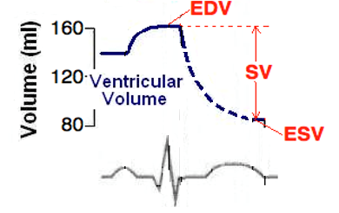
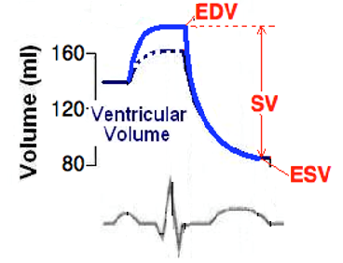
Stroke Volume
During exercise, the S-NS is activated:
Heart contracts more forcefully and ejects more blood
Thus, ESV decreases
Meanwhile, the heart is filling with more blood
Thus, EDV increases

Slide 71
Stroke Volume and Preload
Preload: the “load” on the cardiac muscle before contraction
This “load” comes from the blood in the ventricles that stretches the ventricular muscle
Thus, higher EDV = greater preload

Slide 72
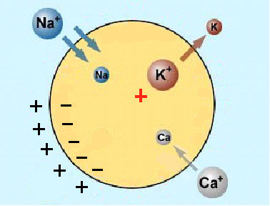
PNS Effect on HR
PNS innervates SA and AV nodes through vagus nerve
PNS releases Ach, which binds to receptors on cells of SA and AV nodes
K⁺ permeability (i.e. more exits cell) and Ca²⁺ permeability (i.e. less enters cell)
Net effect:
K⁺ = HYPERPOLARIZATION
Ca²⁺ = Decreases slope of pacemaker potential

Slide 73
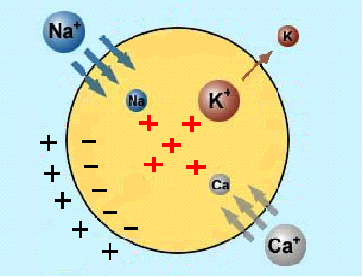
SNS Effect on HR
SNS innervates SA, AV nodes and ventricular muscles
SNS releases NE, which binds to receptors on cells of nodes and muscle
Na⁺ and Ca²⁺ permeability (i.e. more enters cell)
Net effect: DEPOLARIZATION and increased slope of pacemaker potential

Slide 74
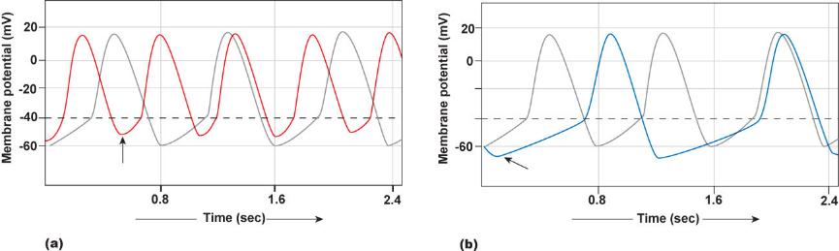
Which graph represents sympathetic influence on heart rate (in both cases the light grey line is under resting conditions)?

Slide 75
Which graph represents sympathetic influence on heart rate (in both cases the light grey line is under resting conditions)?

Slide 76
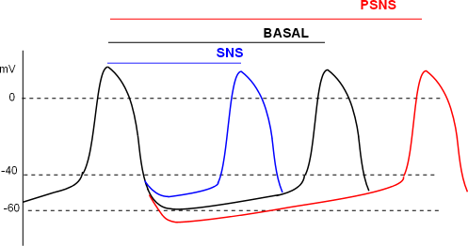
Summary of ANS Control of Heart Rate
PSNS
Acetylcholine released onto SA/AV node
Decreases heart rate and force of contraction
Increase K⁺, decrease Ca²⁺ permeabilities
Decreases slope of pacemaker potential
SNS
Release norepinephrine onto SA/AV node
Increases heart rate and force of contraction
Increase Na⁺ and Ca²⁺ permeability
Increase slope of pacemaker potential

Slide 77
Frank-Starling Law
Frank-Starling Law states that “an increase in EDV will increase stroke volume”
An increase in EDV = An increase in preload
Increases the stretch of myocardial cells
Increases the force of contraction of these cells when the heart contracts
Increases the amount of blood ejected
Increases Stroke Volume (Increases Cardiac Output)

Slide 78
Frank-Starling Law and Venous Return
How to increase EDV? Increase venous return to the heart!
During dynamic exercise:
Muscle Pump: contracted skeletal muscle around veins pushes blood to heart
Respiratory Pump: changes in pressure during breathing pushes blood towards the heart
S-NS: constriction of veins squeezes blood to heart

Slide 79
Frank-Starling Law and Venous Return

Slide 80
The aortic semilunar valve prevents blood from returning to the _____.
left ventricle
aorta
right ventricle
left atrium

Slide 81
The aortic semilunar valve prevents blood from returning to the _____.
left ventricle
aorta
right ventricle
left atrium

Slide 82
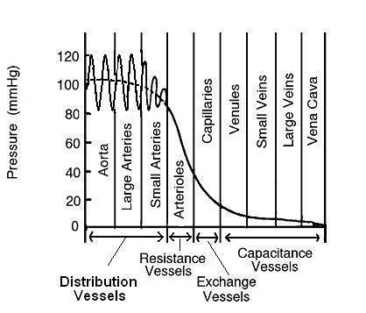
Blood Vessels
Structural properties of vessels are what contribute to the blood pressure characteristics seen in circulation

Slide 83
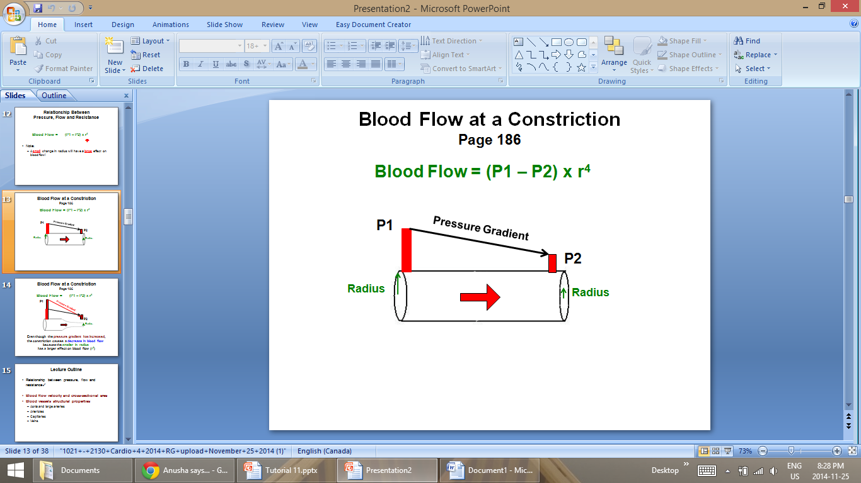
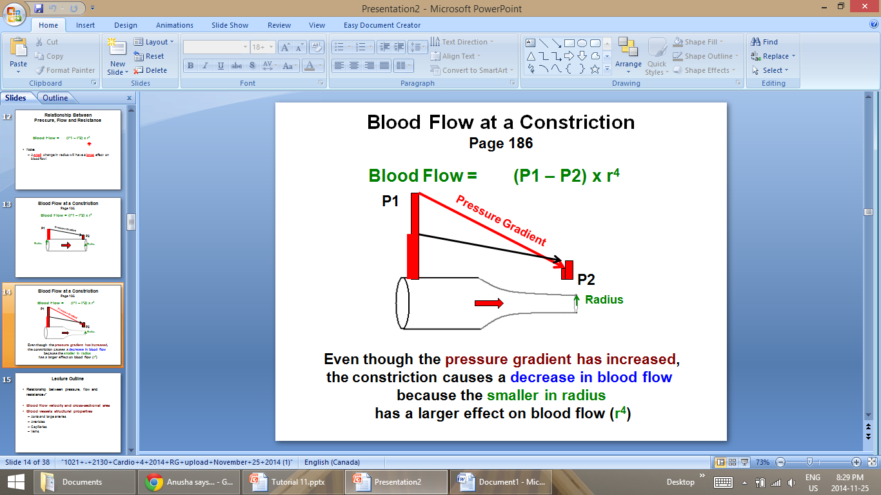
Vessel Constriction and Blood Flow
As the radius decreases the pressure gradient increases.

Slide 84
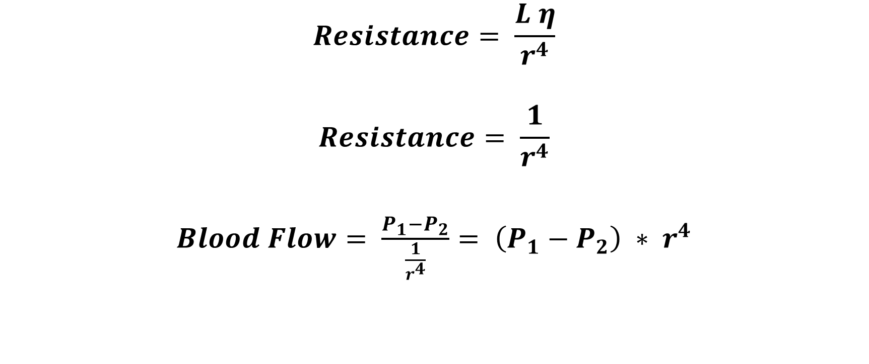
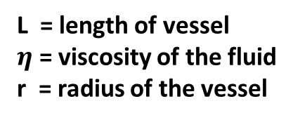
Relationship Between Pressure, Flow and Resistance (Page 232)
$$Resistance= \frac{L η}{r^{4}}$$
$$Resistance= \frac{1}{r^{4}}$$
$Blood Flow= \frac{P_{1}−P_{2}}{\frac{1}{r^{4}}}= \left(P_{1}−P_{2}\right) ∗ r^{4}$
L = length of vessel
$η$ = viscosity of the fluid
r = radius of the vessel
Just know this part of the equation
A small change in radius will have a LARGE effect on blood flow

Slide 85
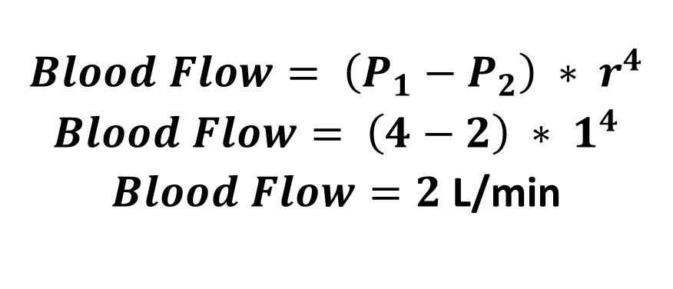
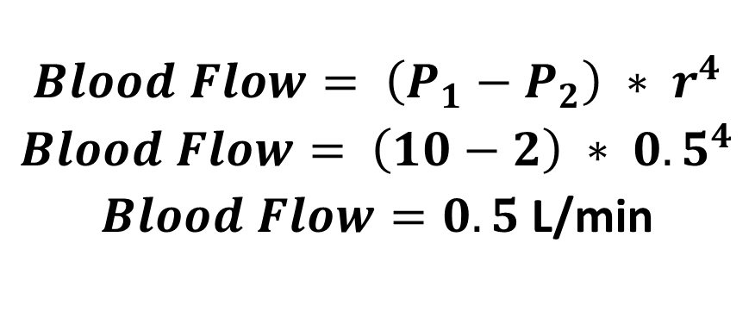
Relationship Between Pressure, Flow and Resistance
$$Blood Flow= \left(P_{1}−P_{2}\right) ∗ r^{4}$$
$Blood Flow= \left(4−2\right) ∗ 1^{4}$
$Blood Flow=2$ L/min
$$Blood Flow= \left(P_{1}−P_{2}\right) ∗ r^{4}$$
$Blood Flow= \left(10−2\right) ∗ {0.5}^{4}$
$Blood Flow=0.5$ L/min
A small change in radius will have a LARGE effect on blood flow

Slide 86
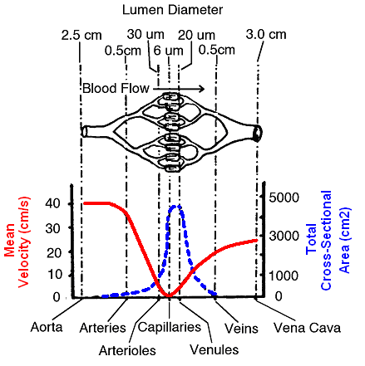
Defining terms
Blood velocity (cm/sec): speed at which blood is moving through particular blood vessel
Fluid flows faster through a narrow tube than a larger tube
As cross sectional area increases mean velocity decreases
Blood flow (L/min): volume of blood moving through set of vessels

Slide 87
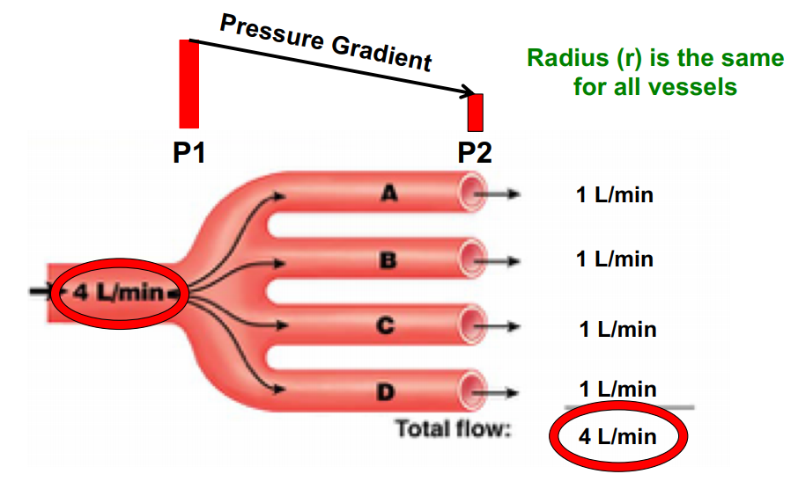
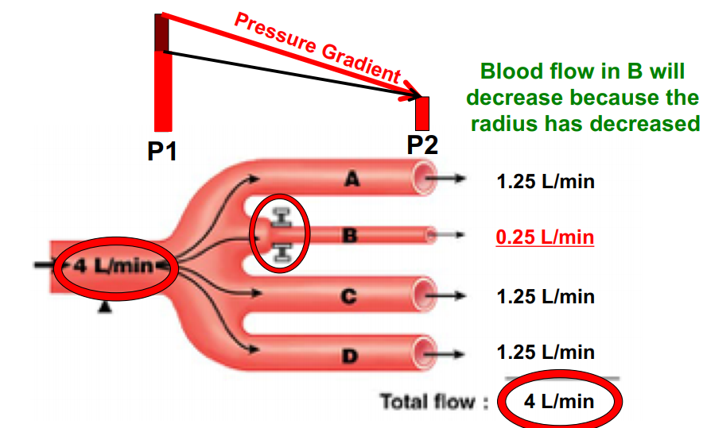
Overall blood flow does not change
Blood flow can change due to constriction in vessel

Slide 88
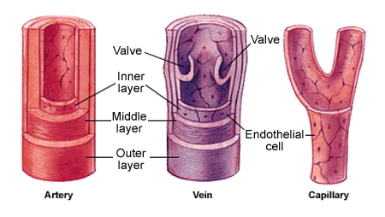
Arteries and Veins
Contain three layers:
Outer Layer – Tunica externa
Fibrous connective tissue
Middle Layer – Tunica media
Smooth muscle and elastic tissue
Inner Layer – Tunica interna
Endothelial cells
Veins contain valves
Capillaries have single layer of endothelial cells

Slide 89
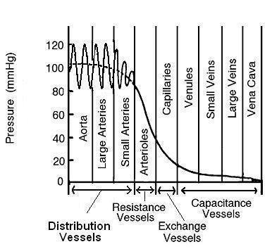
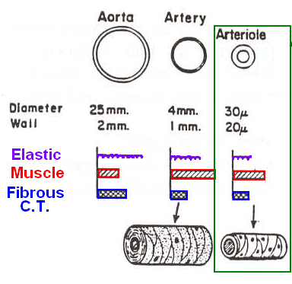
Aorta and Large Arteries
 | Blood Characteristics | Structure | Purpose
Aorta/Large Arteries | High blood pressure 80-120 mmHg High blood velocity | Large diameter Elastic tissue Thin walls Easily distended Low resistance to blood flow Small drop in blood pressure | ‘Shock absorbers’ Distribute the blood

Slide 90
Arterioles
 | Blood Characteristics | Structure | Purpose
Arterioles | Large drop in blood pressure Lower blood velocity | Small diameter Very thick walls Smooth muscle of walls innervated by ANS Causes vasoconstriction/dilation Controls blood flow velocity | Resistance vessels Control blood flow velocity to organs

Slide 91
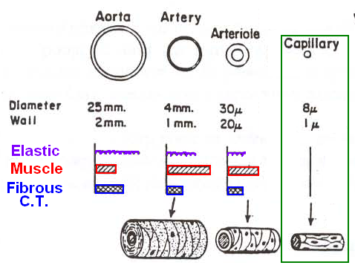
Capillaries
 | Blood Characteristics | Structure | Purpose
Capillaries | Low blood pressure Small drop in blood pressure Very low blood velocity (1-2 cm/sec) | One endothelial cell thick Large cross sectional area Very large surface area Diffusion of gas, nutrients and waste | Exchange vessels

Slide 92
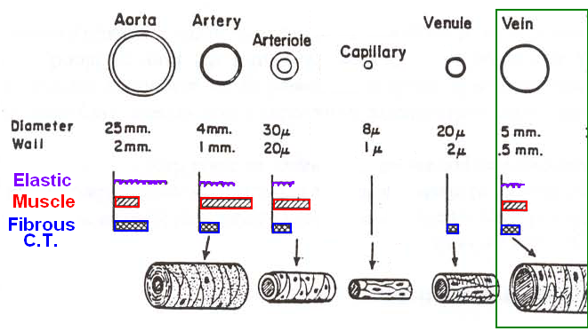
Veins
 | Blood Characteristics | Structure | Purpose
Veins | Low blood pressure Low to medium blood velocity (5-10 cm/sec) | Very thin walls with large diameter Contain valves Some elastic tissue Smoth of smooth muscle innervated by ANS Vasoconstriction/dilation | Capacitance vessels: 70% of TBV

Slide 93
At the arteriolar end of a capillary, __________ pushes fluid into the capillary:
hydrostatic pressure in the interstitial fluid
osmotic pressure in the interstitial fluid
osmotic pressure in the capillary
hydrostatic pressure in the capillary

Slide 94
At the arteriolar end of a capillary, __________ pushes fluid into the capillary:
hydrostatic pressure in the interstitial fluid
osmotic pressure in the interstitial fluid
osmotic pressure in the capillary
hydrostatic pressure in the capillary

Slide 95
Starling Forces
Two hydrostatic pressures
Capillary hydrostatic pressure
Interstitial fluid hydrostatic pressure
Two osmotic pressures
Plasma osmotic pressure
Interstitial osmotic pressure

Slide 96
Exchange In Capillaries
Diffusion
Down concentration gradients
Oxygen, CO², O², lipid soluble substances
Filtration and reabsorption (Starling forces)
Filtration: movement of fluid out of capillary
Reabsorption: movement of fluid back into capillary

Slide 97
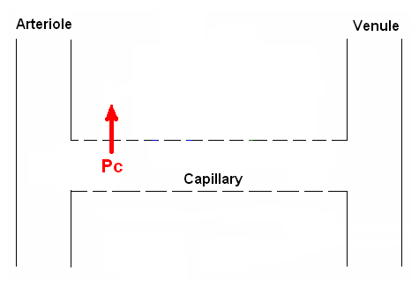
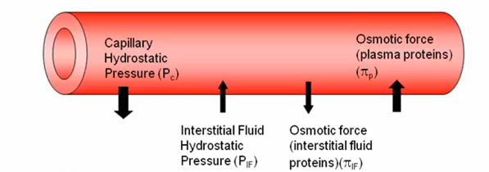
Capillary Hydrostatic Pressure (P_{c})
Pressure exerted by fluid in the capillary
Pressure drives fluid OUT of capillary and is generated by ventricular systole (Filtration)
25 mmHg
10 mmHg

Slide 98
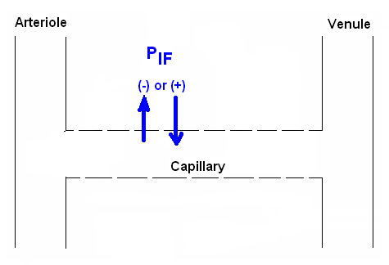
Interstitial Fluid Hydrostatic Pressure (P_{IF})
Pressure exerted by fluid in the interstitial space between cells in the tissue
Movement depends on pressure in the tissue
Can be negative → Filtration into tissue
Can be positive → Reabsorption into capillary
Subcutaneous tissues: -6mmHg
Interstitial fluid: +6mmHg

Slide 99
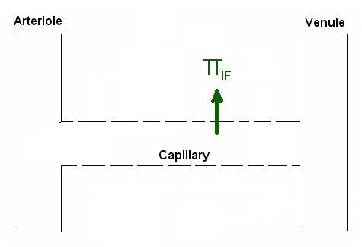
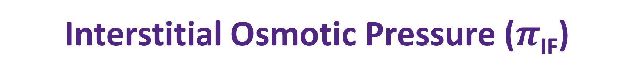
Interstitial Osmotic Pressure ($π$_{IF})
Pressure caused by osmosis due to few proteins in interstitial fluid (5mmHg)
Pressure drives fluid OUT of capillary and into tissue (Filtration)

Slide 100
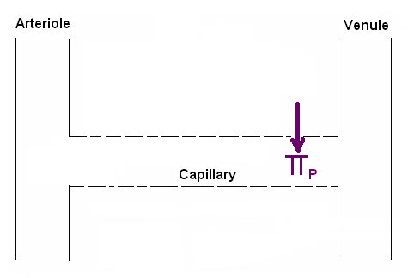

Plasma Osmotic Pressure ($π$_{P})
Pressure caused by osmosis due to proteins in plasma (28mmHg)
Pressure drives fluid INTO capillary (Reabsorption)

Slide 101
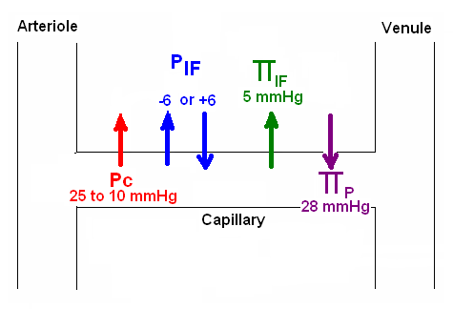
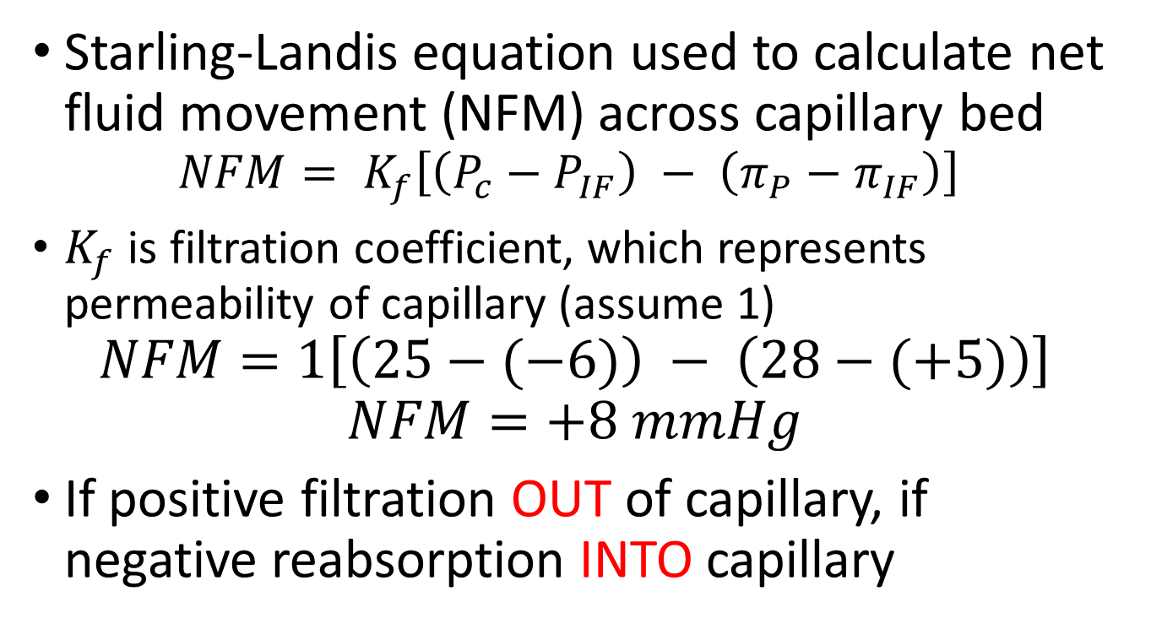
Balance of Starling Forces
Starling-Landis equation used to calculate net fluid movement (NFM) across capillary bed
$$NFM= K_{f}\left[\left(P_{c}−P_{IF}\right) − \left(π_{P}−π_{IF}\right)\right]$$
$K_{f}$ is filtration coefficient, which represents permeability of capillary (assume 1)
$$NFM=1\left[\left(25−(−6)\right) − \left(28−(+5)\right)\right]$$
$$NFM=+8 mmHg$$
If positive filtration OUT of capillary, if negative reabsorption INTO capillary

Slide 102
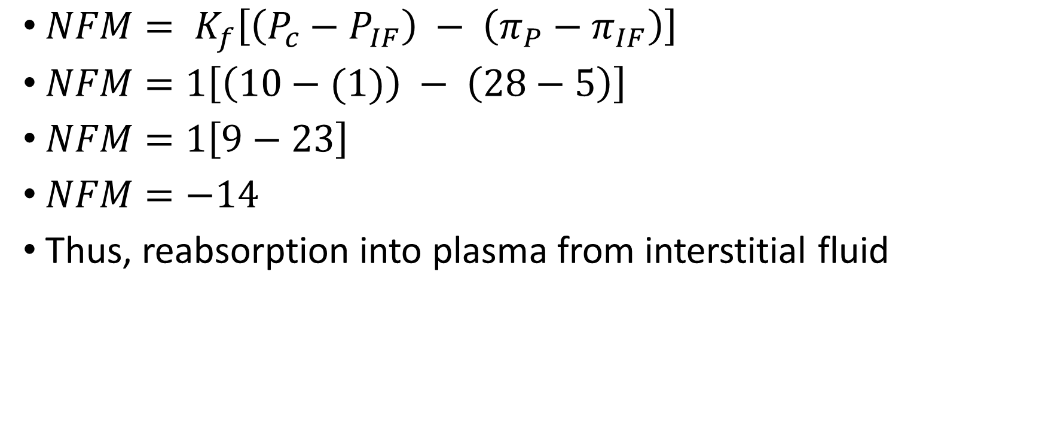
P_{C} = 10, P_{IF} = 1, π_{IF} = 5, π_{C} = 28
$NFM= K_{f}\left[\left(P_{c}−P_{IF}\right) − \left(π_{P}−π_{IF}\right)\right]$
$NFM=1\left[\left(10−(1)\right) − \left(28−5\right)\right]$
$NFM=1\left[9−23\right]$
$NFM=−14$
Thus, reabsorption into plasma from interstitial fluid

Slide 103
Local Intrinsic Mechanisms: Myogenic Theory
Maintain blood flow when there is change in blood pressure
Increase in blood pressure → contraction of smooth muscles in arterioles (Vasoconstriction)
Decrease in blood pressure → relaxation of smooth muscles in arterioles (Vasodilation)
Increase in blood pressure
Stretches walls of arterioles
Smooth muscles in walls contract
Vasoconstriction
Decrease blood flow/pressure

Slide 104
Local Intrinsic Mechanisms: Metabolic Theory
Active tissue releases metabolic by-products called vasodilator metabolites (VDMs)
Increase in: CO², [H⁺], adenosine, temperature
Decrease in: O²
Increase in VDMs → relaxation of smooth muscles in vessels (Vasodilation)
Leads to increase in blood flow rate

Slide 105
Humoral Mechanisms
Regulation by substances present in blood
Vasoconstrictor agents
Epinephrine: attaches to alpha receptors in blood vessels
Weak vasoconstriction
Angiotensin II: production stimulated by drop in blood pressure and drop in sodium levels
Very potent vasoconstrictor
Vasopressin: formed in the hypothalamus, promotes reabsorption of water in kidneys
High amounts will produce vasoconstriction

Slide 106
Humoral Mechanisms
Regulation by substances present in blood
Vasodilator agents:
Epinephrine: attaches to beta receptors in blood vessels of skeletal/cardiac muscle and the liver
Causes vasodilation
Kinins: blood protein involved in inflammation, blood pressure and blood coagulation
Histamine: released by damaged cells, involved in inflammatory response
Atrial natriuretic factor: released by atrial muscle cells
Very powerful vasodilator

Slide 107
Neural Control Mechanisms
ANS can rapidly induce changes in blood flow by vasodilation/constriction
Sympathetic nervous system:
Norepinephrine released onto blood vessels → vasoconstriction
Acetylcholine causes release of epinephrine from adrenal glands
Alpha receptors constrict
Beta receptors dilate
Parasympathetic nervous system:
Small indirect effect on blood vessels, causes weak vasodilation
Indirect because SNS is shut off

Slide 108
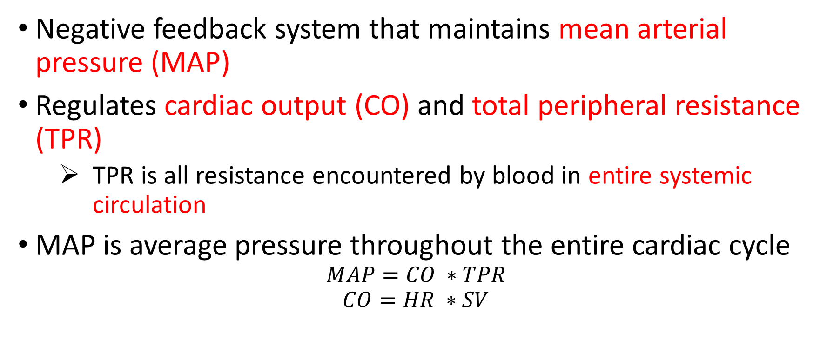
Baroreceptor Reflex
Negative feedback system that maintains mean arterial pressure (MAP)
Regulates cardiac output (CO) and total peripheral resistance (TPR)
TPR is all resistance encountered by blood in entire systemic circulation
MAP is average pressure throughout the entire cardiac cycle
$$MAP=CO ∗TPR$$
$$CO=HR ∗SV$$

Slide 109
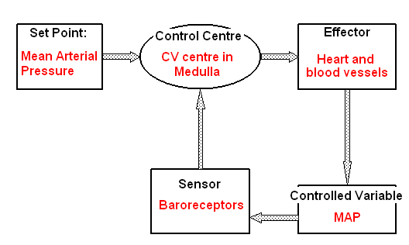
Baroreceptor Reflex

Slide 110
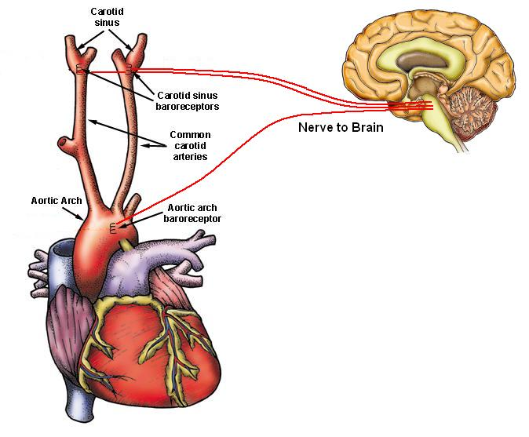
Baroreceptor Reflex
Located in walls of aortic arch and carotid sinuses
Stretch sensitive receptors that monitor blood pressure
Send APs back to cardiovascular center in the medulla of brainstem

Slide 111
Baroreceptor Reflex
Increase in blood pressure (MAP)
Stretches aorta/carotid sinuses
CV center compares signals to set point
Shuts off SNS activates PNS
Decrease CO ( HR and SV causes vasodilation ( TPR))
APs sent to CV center in medulla
Activates baroreceptors
Decreases MAP

Slide 112
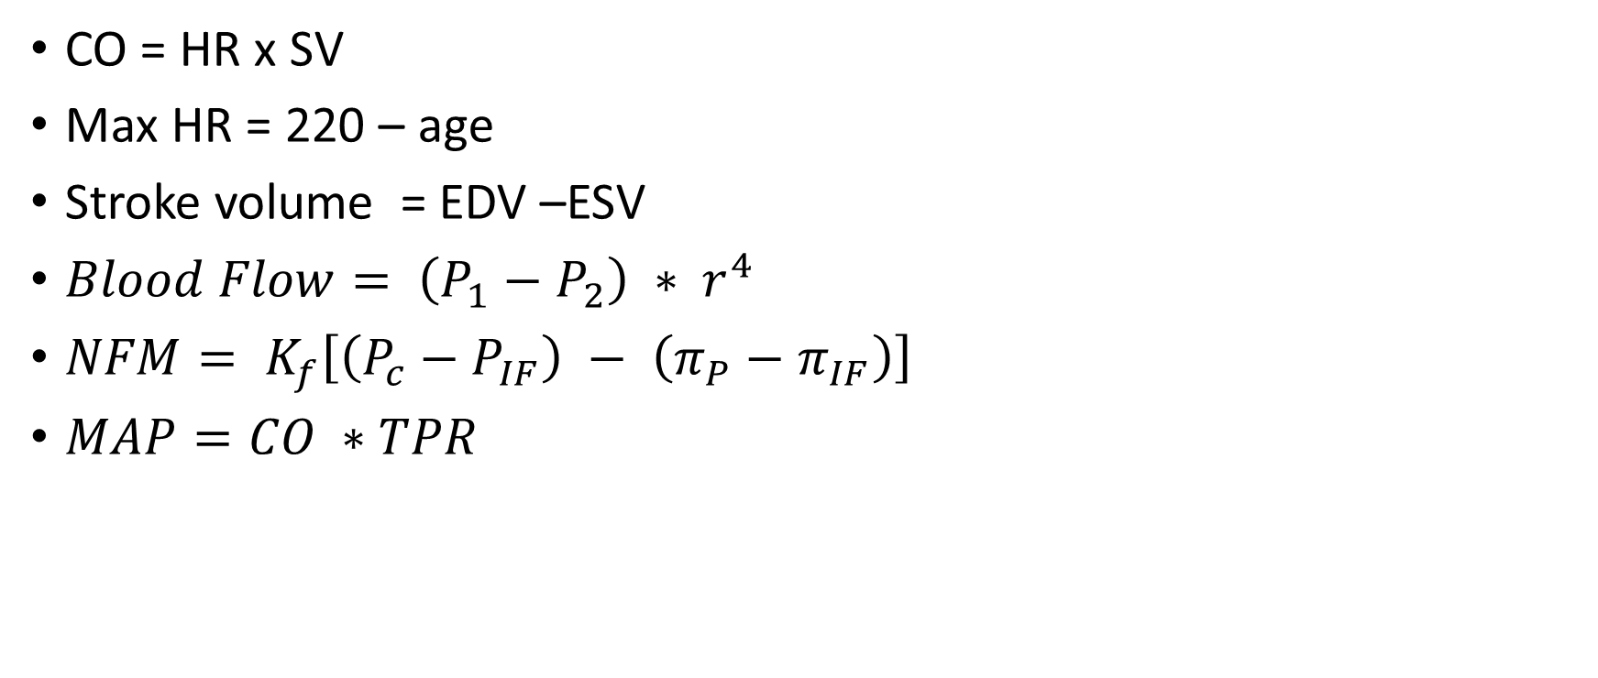
Equations to know
CO = HR x SV
Max HR = 220 – age
Stroke volume = EDV –ESV
$Blood Flow= \left(P_{1}−P_{2}\right) ∗ r^{4}$
$NFM= K_{f}\left[\left(P_{c}−P_{IF}\right) − \left(π_{P}−π_{IF}\right)\right]$
$MAP=CO ∗TPR$

Slide 113
What Questions Do You Have?
You can ask in the Owl forums as well!
Also anonymously ask questions in the online dropbox!!

